Slide 1
Scientific Method: Global Warming
The theory:
Global temperatures have warmed over past 130+ years.
Warming caused by human released CO₂ into the atmosphere.
Assumed theory:
increased CO₂ leads to increasing temperatures

Slide 2
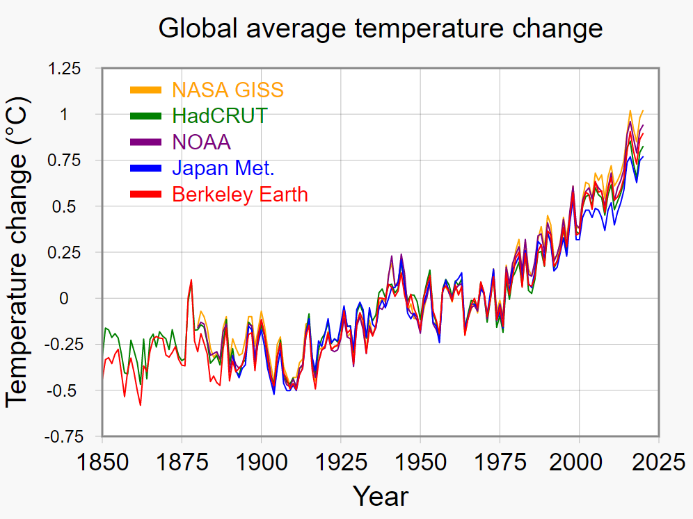
Evidence: data vs. interpretation

Slide 3
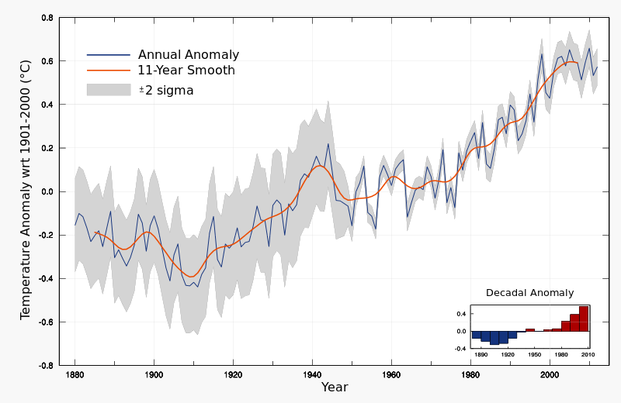
Evidence: data vs. interpretation
No warming in 20+ years!
+1°C
No warming for ≈40 years!

Slide 4
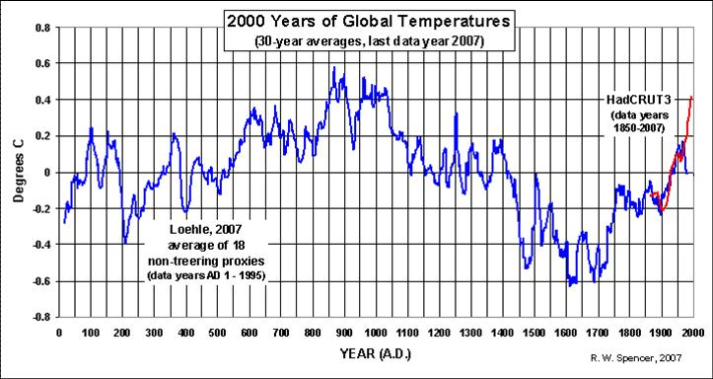
What if we extend further back in time?

Slide 5
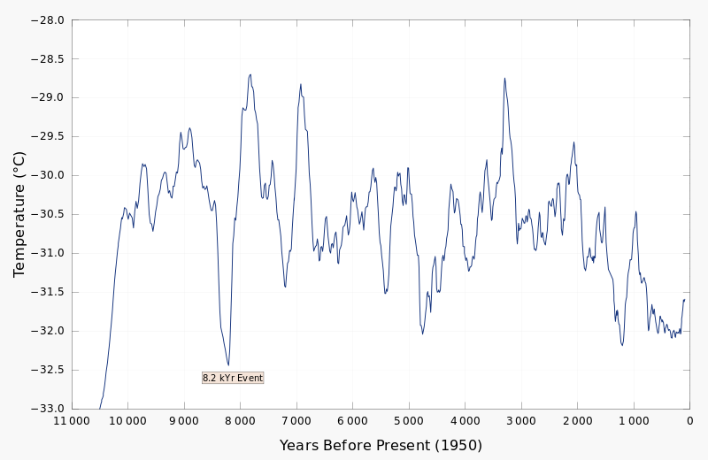
…. even further back?

Slide 6
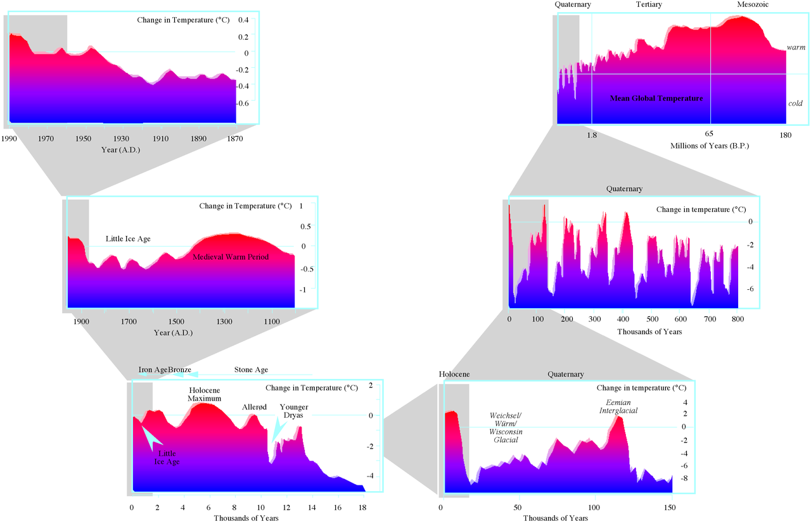
Any time scale, same answer.

Slide 7
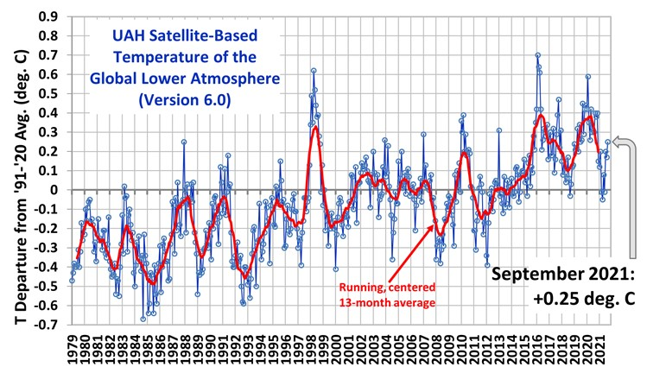
Evidence: data vs. interpretation
Satellite temperature data shows….

Slide 8
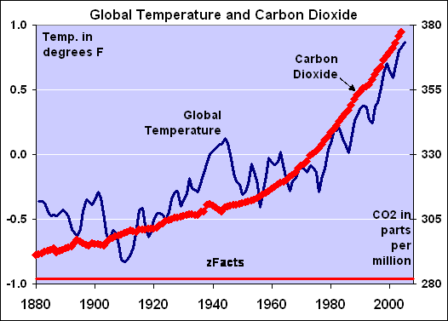
Theory: Rising CO₂ is causing warming
So, what happened here?
Notes:
8

Slide 9
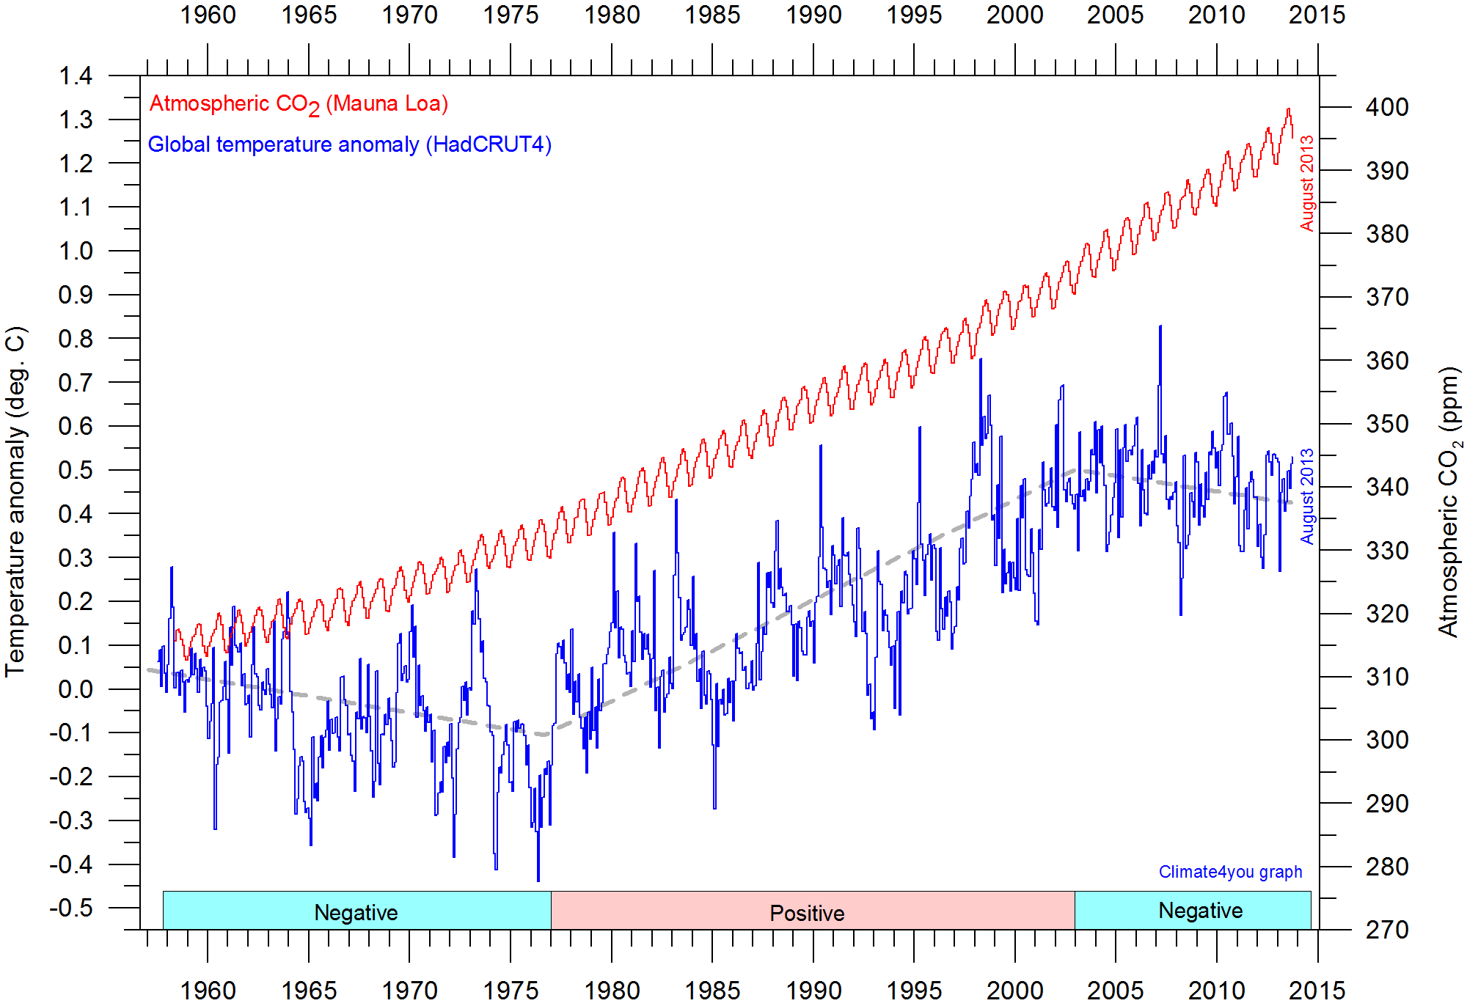
Theory: Rising CO₂ is causing warming
…. and here?
Notes:
9

Slide 10
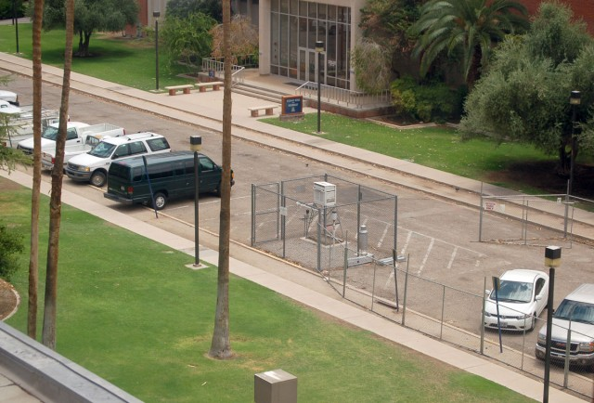
Evidence: Data We can at least agree on the data, right?

Slide 11
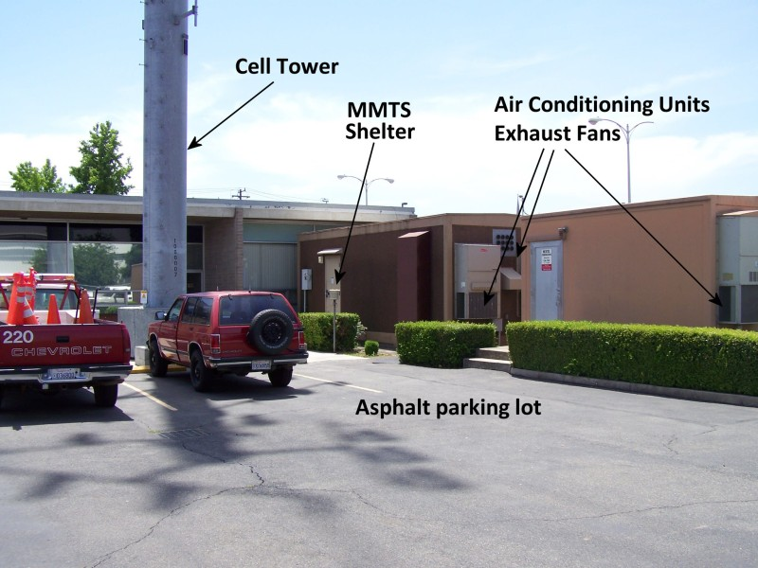
Evidence: Data We can at least agree on the data, right?

Slide 12
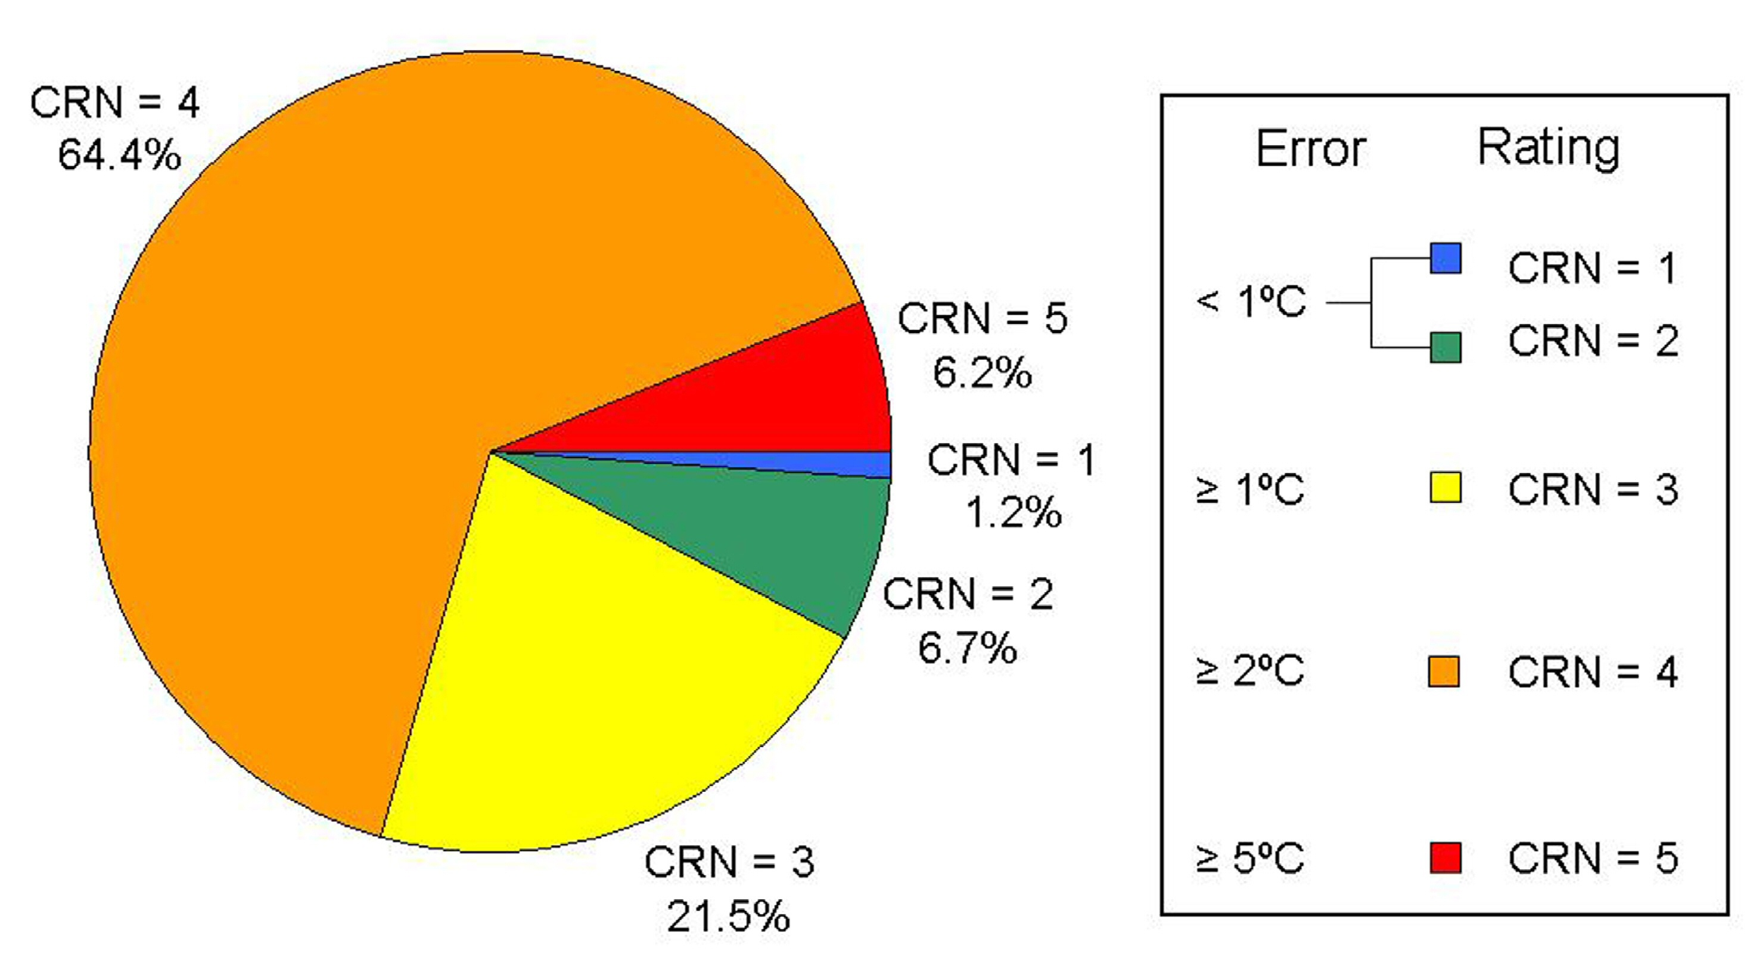
Evidence: Data We can at least agree on the data, right?

Slide 13
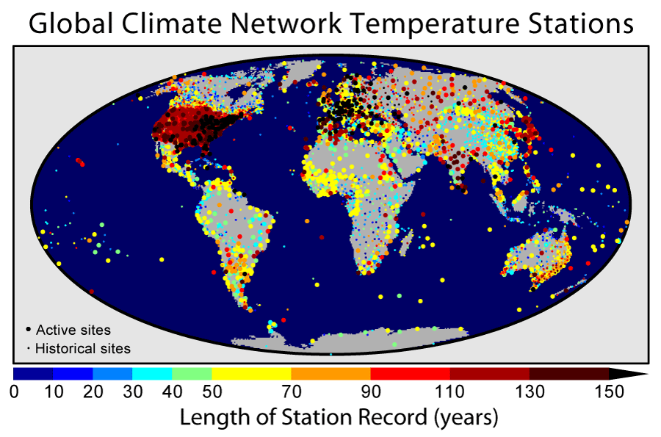
Evidence: Data We can at least agree on the data, right?

Slide 14
Science? Scientific Method?
Put forward theory
Test theory
If theory fails even one test... It fails!
You must discard theory!
Theory:
Global temperatures have warmed.
CORRECT!
Warming caused by human CO2.
FAIL!
Assumed theory:
increased CO2 = increasing temperatures
(The “Greenhouse Gas” concept)
FAIL!

Slide 15
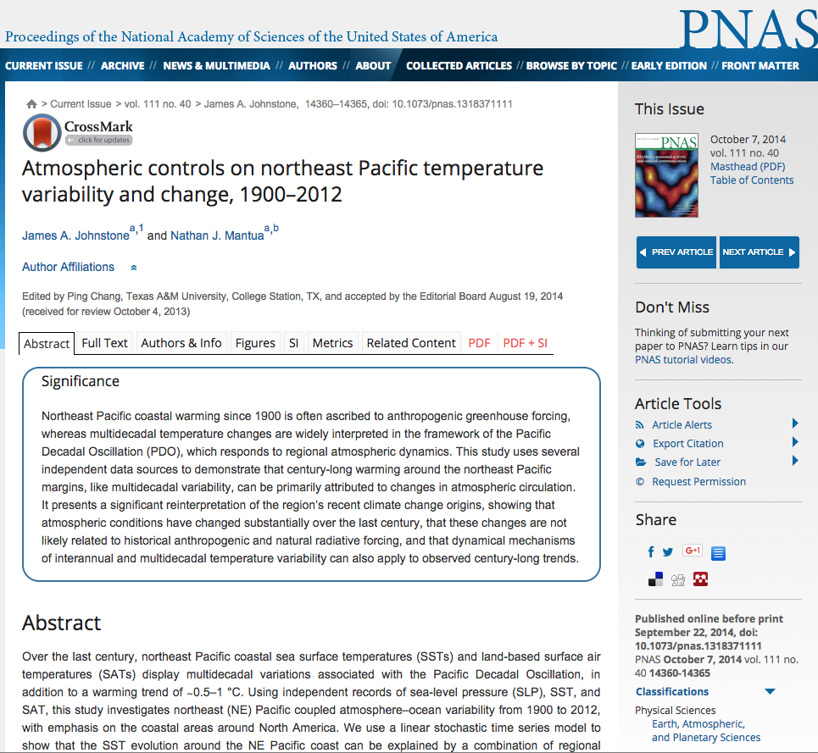
Scientific Consensus
“These results suggest that natural internally generated changes in atmospheric circulation were the primary cause of coastal NE Pacific warming from 1900 to 2012…”

Slide 16
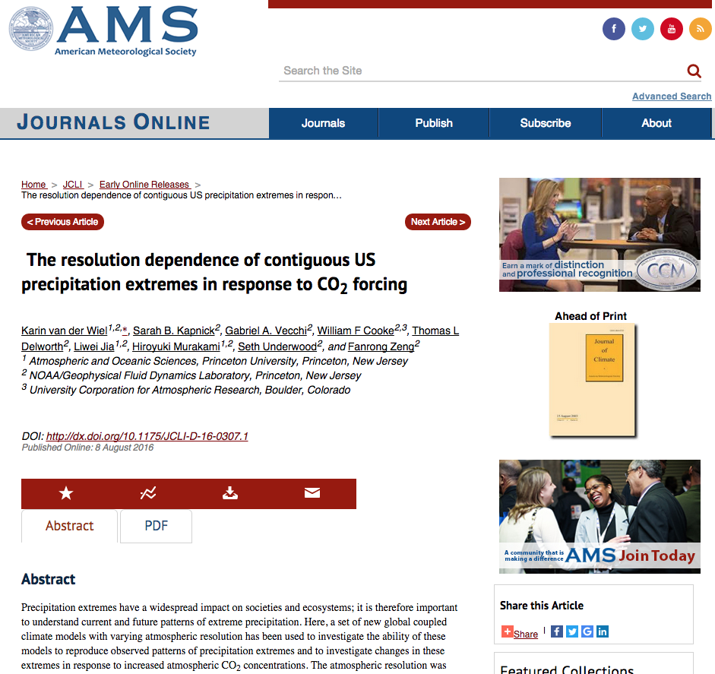
Scientific Consensus
“In part because of large intrinsic variability, no evidence was found for changes in extreme precipitation attributable to climate change in the available observed record.”

Slide 17
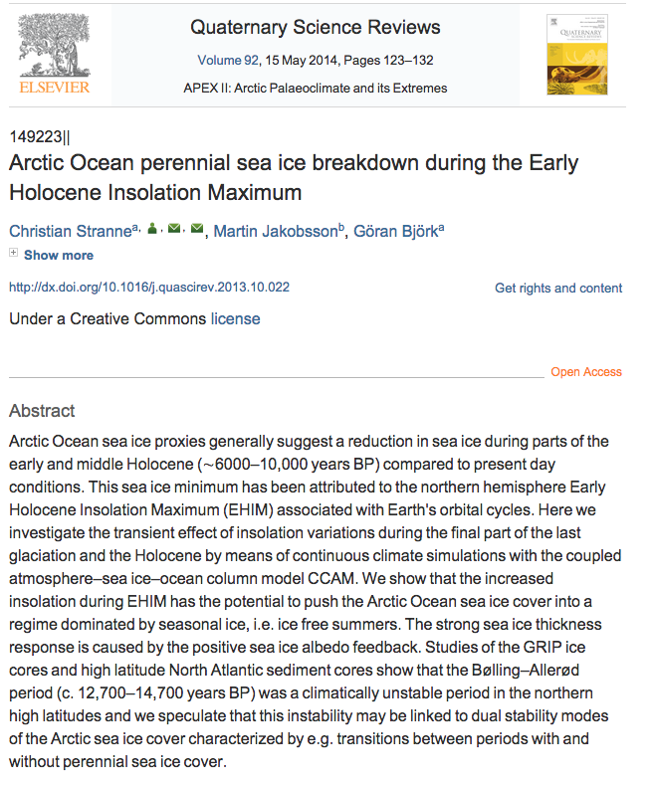
Scientific Consensus
“We show that the increased insolation during EHIM* has the potential to push the Arctic Ocean sea ice cover into a regime dominated by seasonal ice, i.e. ice free summers.” (*6000-10,000 yrs ago)

Slide 18
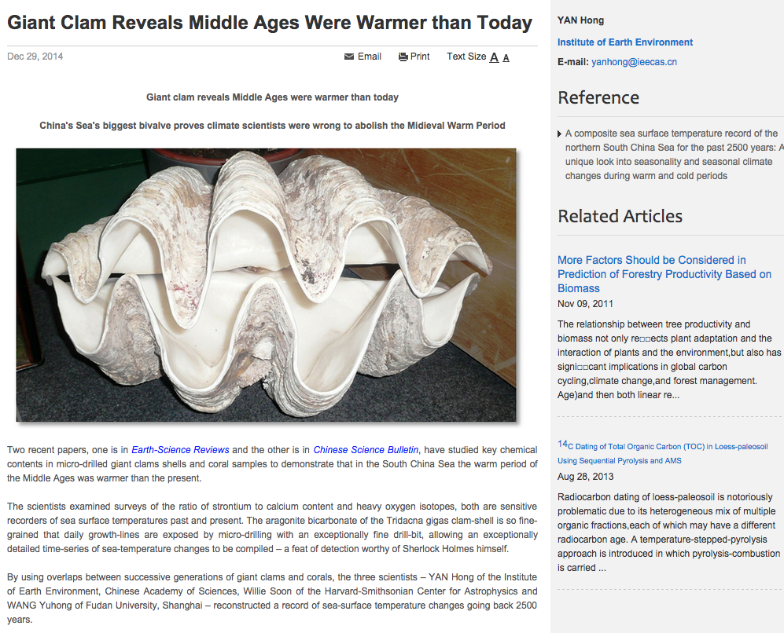
Scientific Consensus
“…disproving the notion that until the warming of the 20th century there had been little change in global temperatures for at least 1000 years, and confirming …there is nothing exceptional about today’s temperatures.”

Slide 19
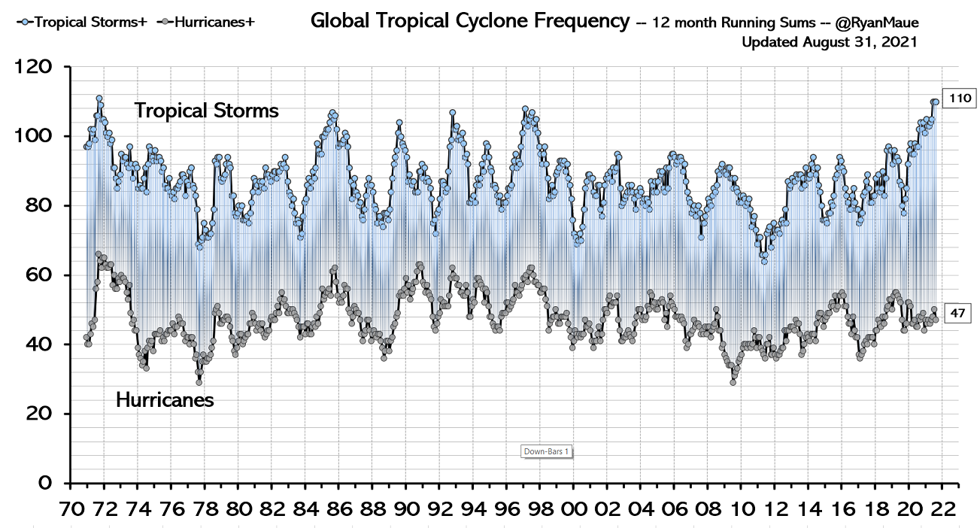
Science? Scientific Method?
“Weather events are becoming more frequent and more powerful”

Slide 20
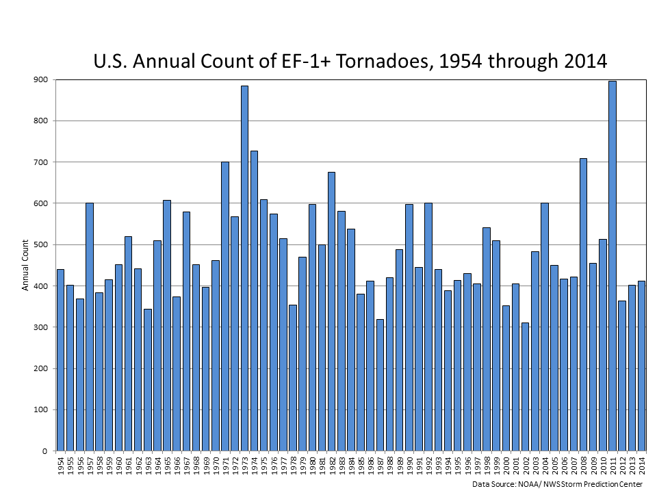
Science? Scientific Method?
“Weather events are becoming more frequent and more powerful”

Slide 21
Science? Scientific Method?
“No amount of experimentation can ever prove me right; a single experiment can prove me wrong.”
-- Albert Einstein

Slide 22
Science? Scientific Method?
“Any physical theory is always provisional, in the sense that it is only a hypothesis: you can never prove it. No matter how many times the results of experiments agree with some theory, you can never be sure that the next time the result will not contradict the theory. On the other hand, you can disprove a theory by finding even a single observation that disagrees with the predictions of the theory.”
- Stephen Hawking, physicist
(emphasis mine)

Slide 23
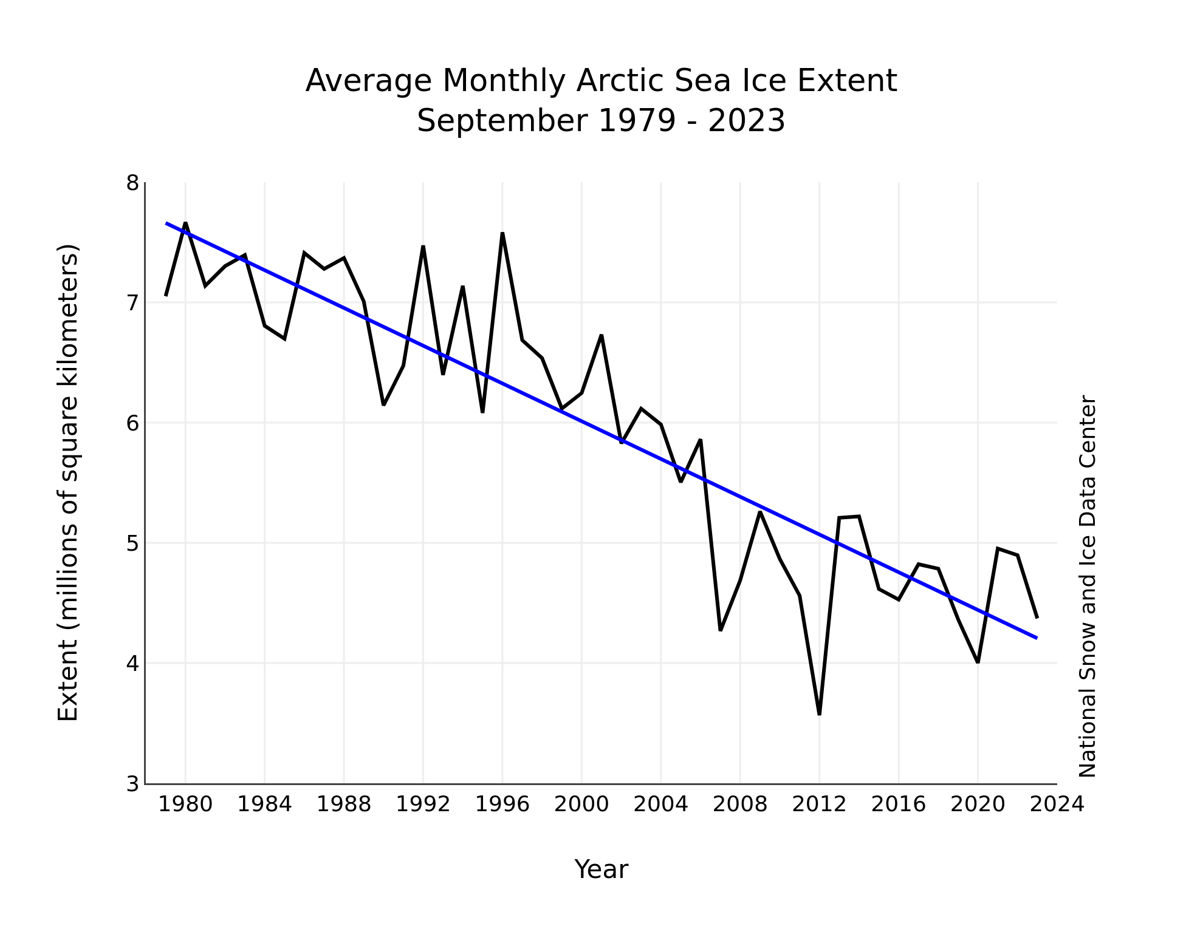
Other Examples?
Polar Ice Melting?
Arctic

Slide 24
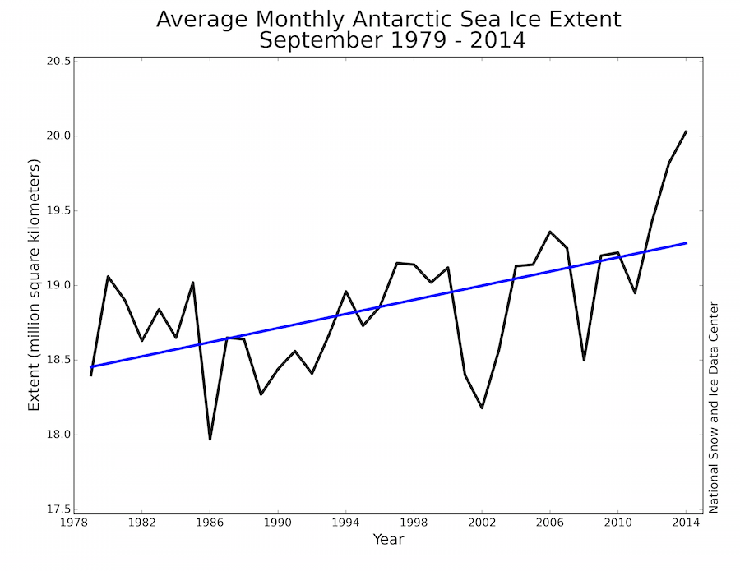
Other Examples?
Polar Ice Melting?
Antarctic

Slide 25
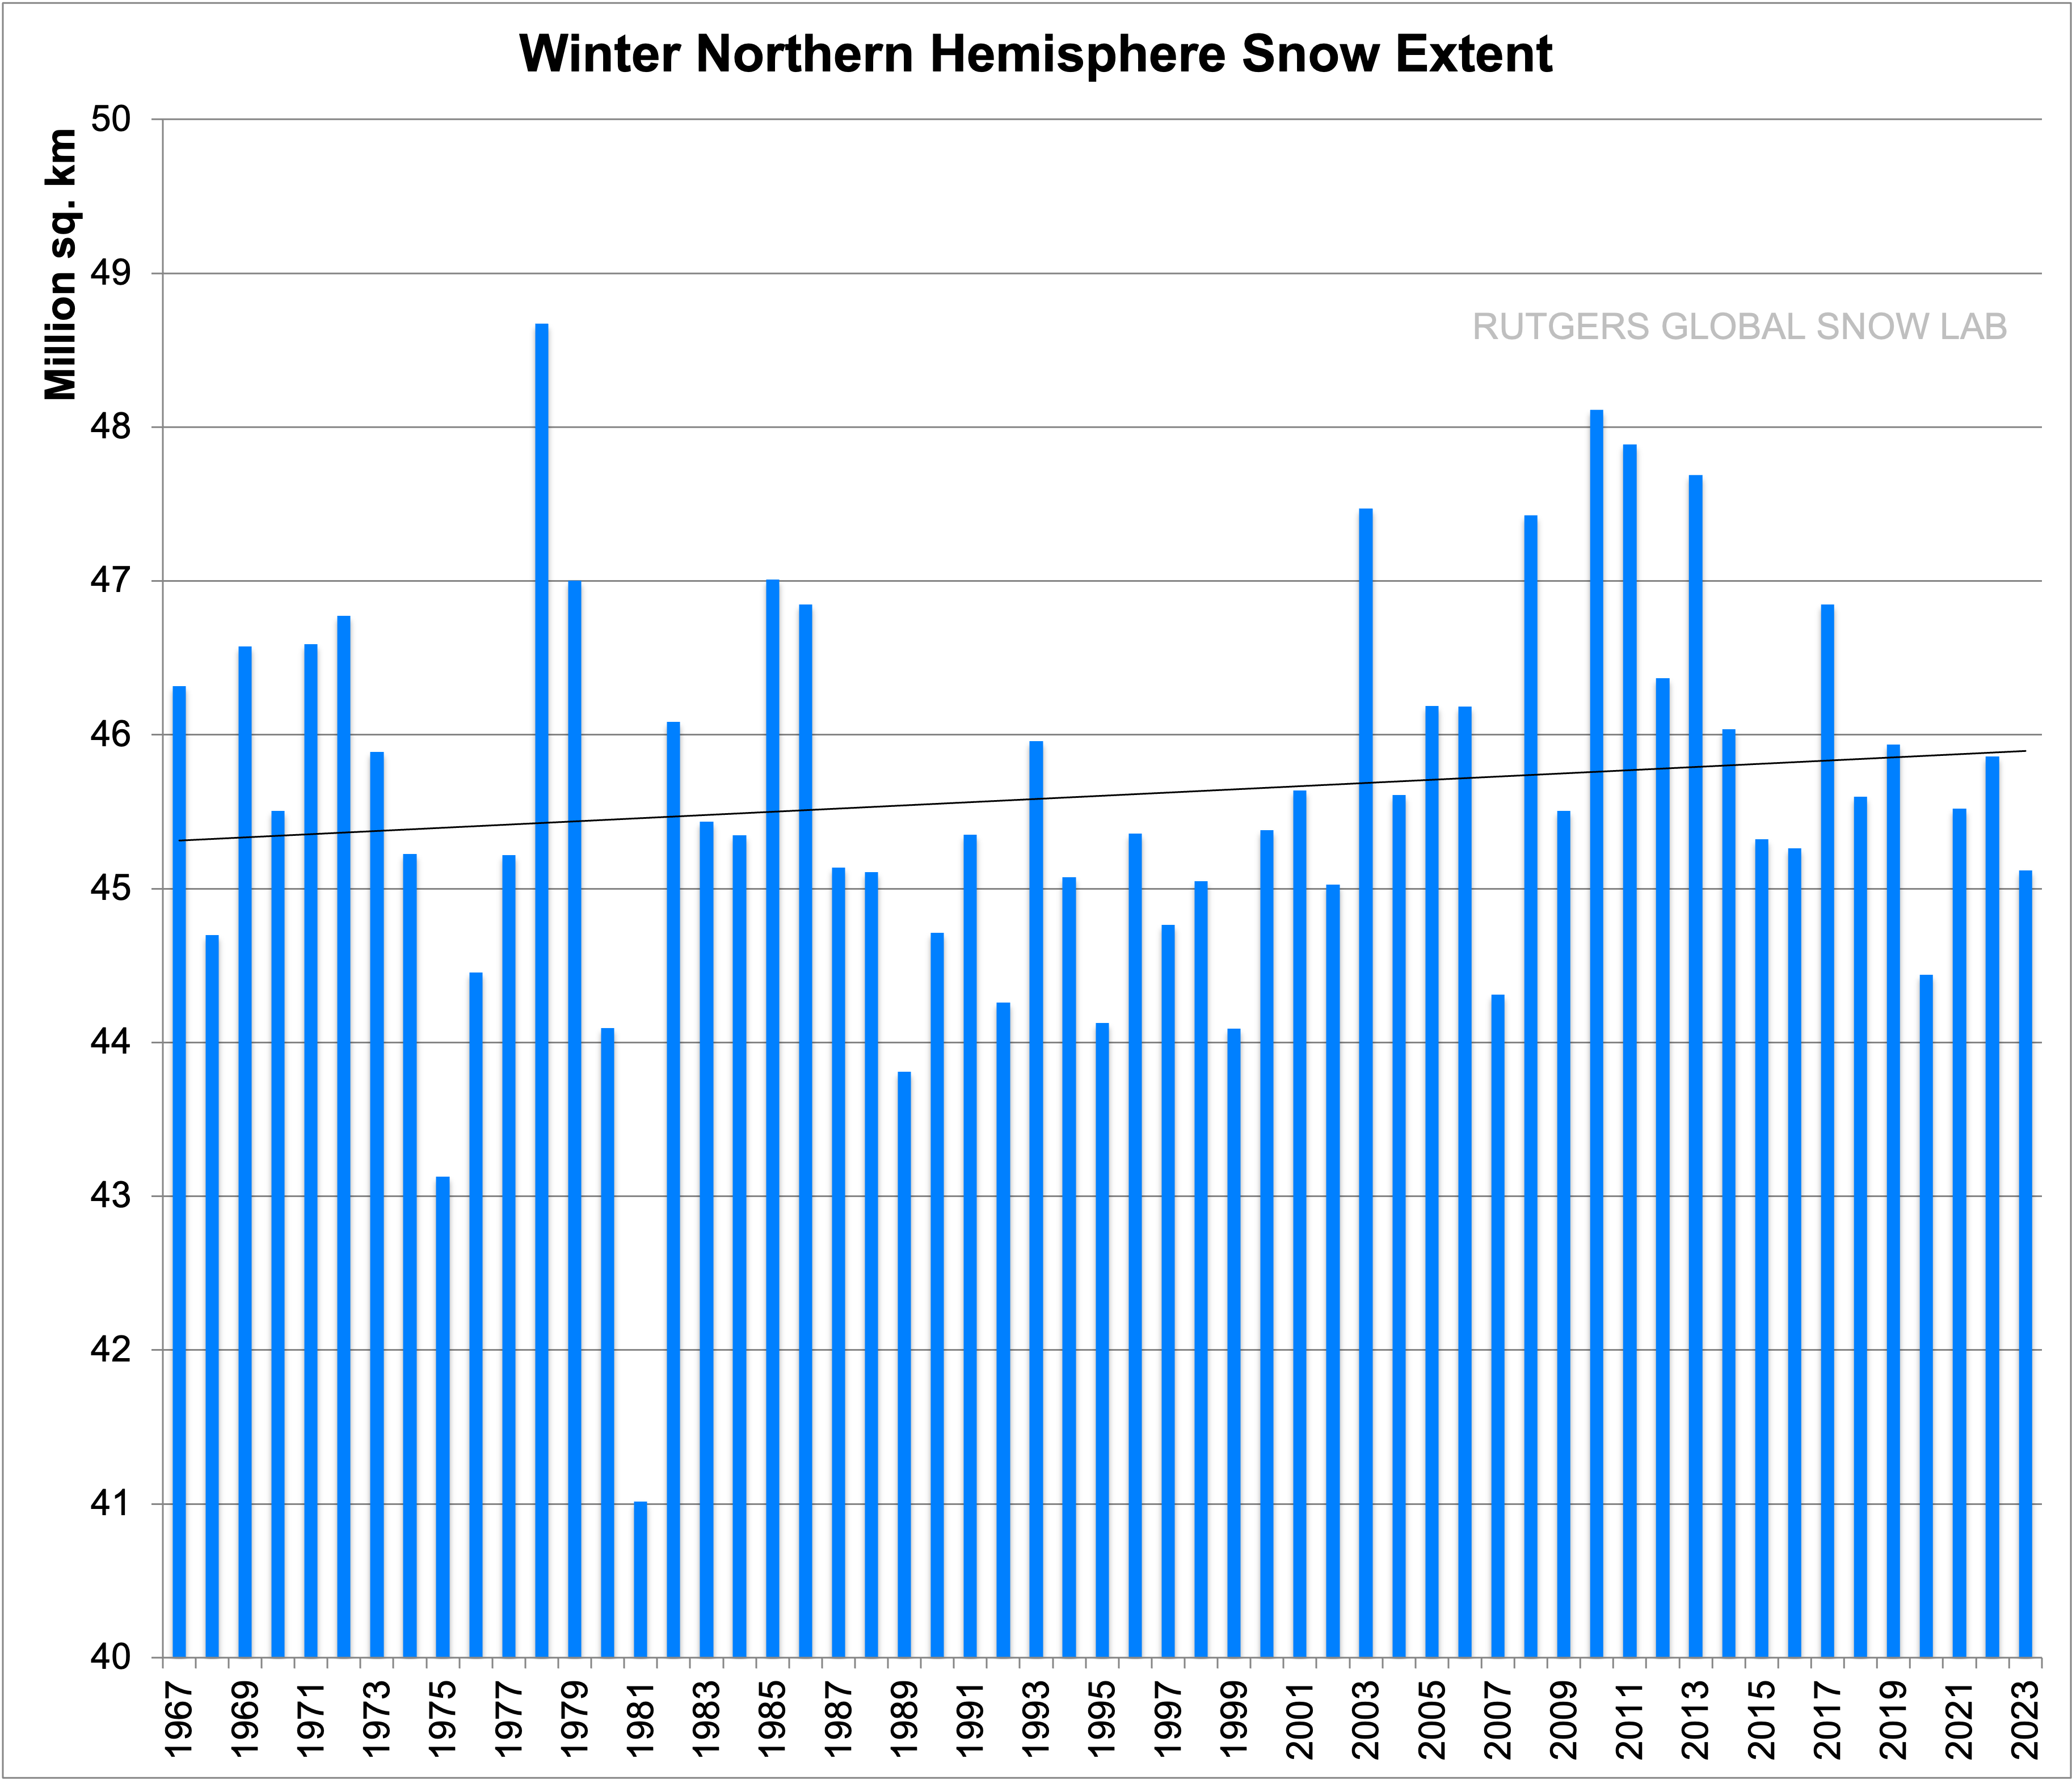
Other Examples?
Polar Ice Melting?

Slide 26
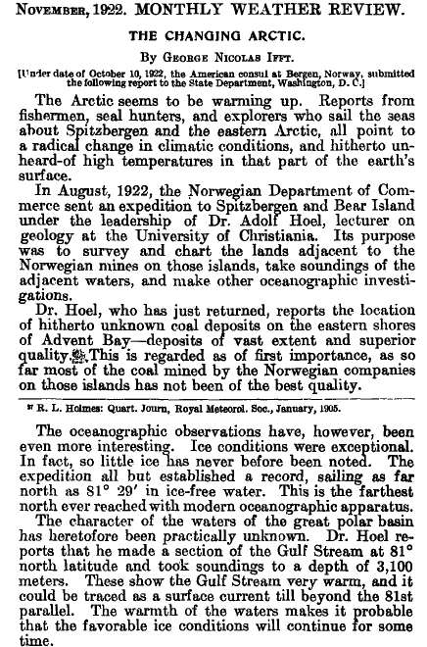
Other Examples?
Polar Ice Melting?
And it has happened before!

Slide 27
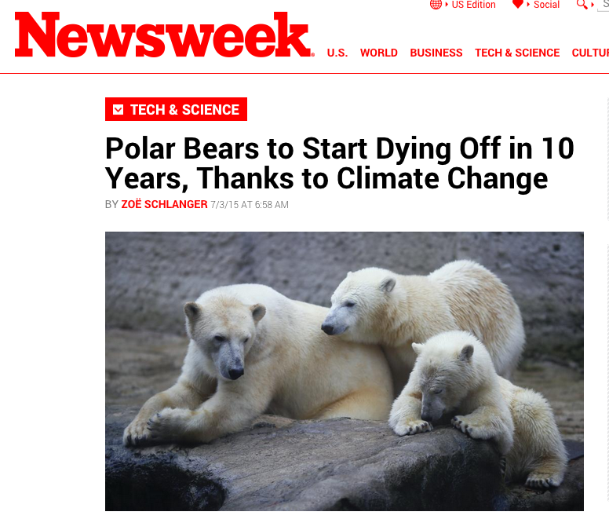
Other Examples?
Environmentalist Claims: Polar Bears are dying

Slide 28
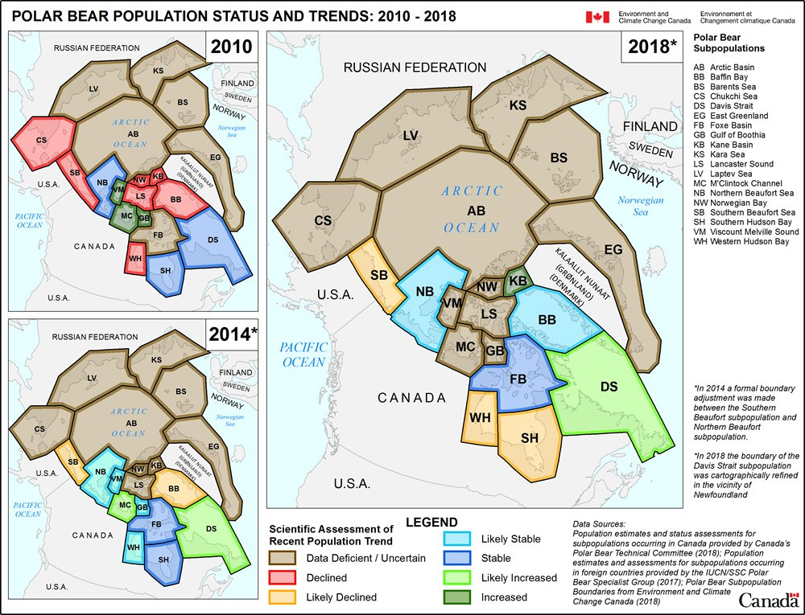
Other Examples?
Environmentalist Claims: Polar Bears are dying

Slide 29
Other Examples?
Environmentalist Claims: Polar Bears are dying
“Some subpopulations of bears haven’t been counted in decades,
if ever”

Slide 30
Beware of the scary story!
"... The whole aim of practical politics is to keep the populace alarmed (and hence clamorous to be led to safety) by an endless series of hobgoblins, most of them imaginary."
H.L. Mencken, In Defense of Women, II.13.

